Slide 1

Goodcabs
Provide Insights & Performance Analysis in Transport Domain
Punam Godugula

Slide 2
Agenda
Problem Statement
Objectives
Data Model
Dashboard Preview
Ad-hoc Analysis
Primary Analysis
Further Analysis & Recommendations
Punam Godugula

Slide 3
Problem Statement
Goodcabs, a leading cab service provider operating in 10 Tier-2 cities in India and supports local drivers while providing excellent service to passengers. The company has set ambitious growth and passengers satisfaction targets for 2024.
The chief operating needs insights on key performance metrics :
Trip Volume
Passenger Satisfaction
Repeat Passenger Rates
Trip Distribution
Balance Between New and Repeat Passengers
Punam Godugula

Slide 4
Objective
To deliver actionable insights on Goodcabs performance in tier-2 cities by analyzing key metrics,
Identify growth opportunities by understanding trip trends.
Enhance Passengers satisfaction through targeted marketing.
Boost customer retention by increasing repeat passenger's rate.
Optimize operations by balancing new and repeat passengers' engagement.
Support strategic decision-making to achieve 2024 performance targets.
Punam Godugula

Slide 5
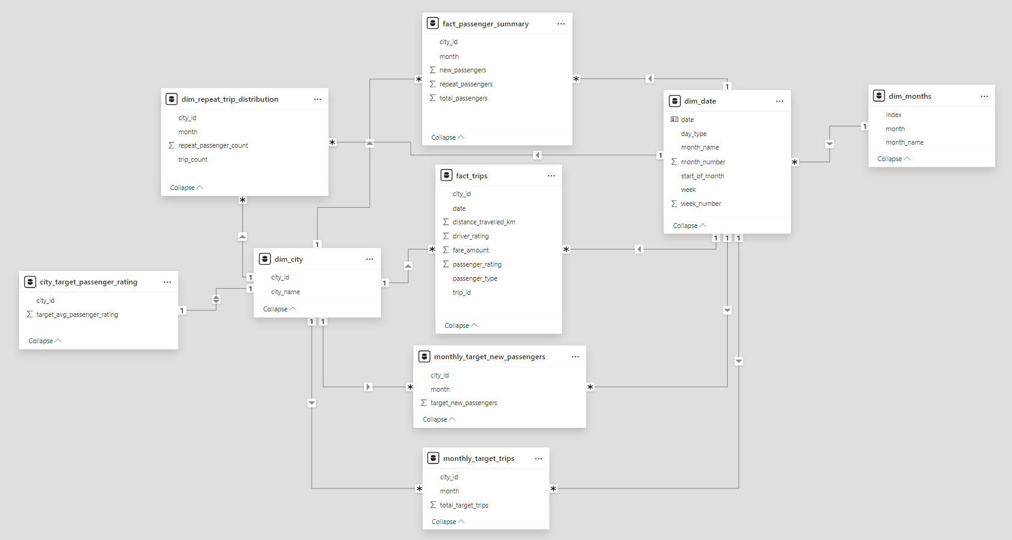
Data Model
Punam Godugula

Slide 6

Power BI Dashboard
Punam Godugula

Slide 7
Ad-hoc Analysis
Punam Godugula

Slide 8
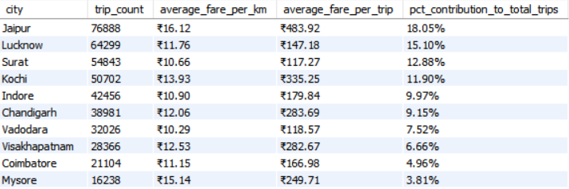
Good Cabs
Business Request-1: City Level Fare and Trip Summary Report
Jaipur leads with the highest trip count (76,888), contributing 18.05% to total trips, indicates strong demand or possibly a larger market size.
Visakhapatnam, Coimbatore, Mysore shows less trip contribution indicates it may be price sensitive or highly competitive.
Punam Godugula

Slide 9
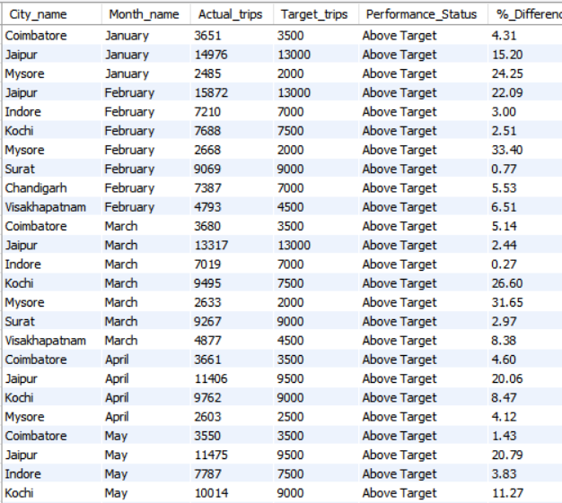
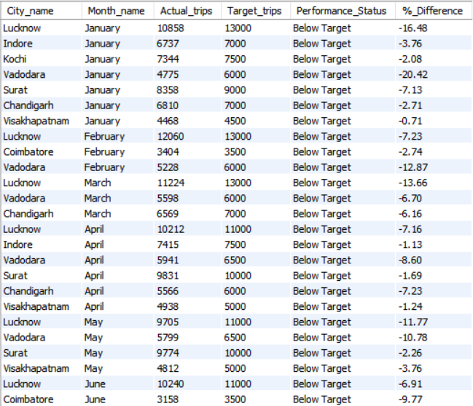
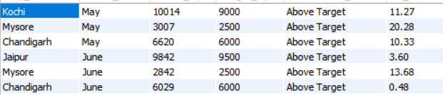
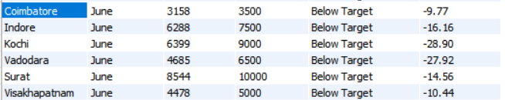
Good Cabs
Business Request -2: Monthly City Level Trips Target Performance
1.
Above Target : February, March, and May, reflecting strong operational efficiency during these periods.
Below Target : January, April, and June, reflecting low operational efficiency during these periods.
Punam Godugula

Slide 10
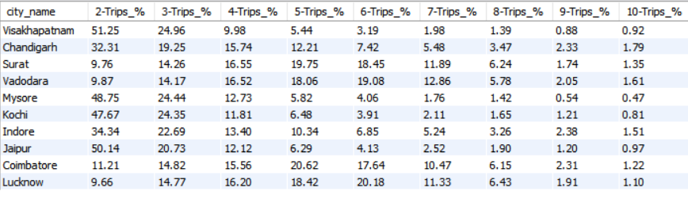
Good Cabs
Business Request-3: City- Level Repeat Passenger Trip Frequency Report
Tourist Cities(Mysore, Jaipur) and Mixed cities (Kochi, Chandigarh) lean towards 2-Trips.
Business cities have good distribution of trip frequency.
Punam Godugula

Slide 11
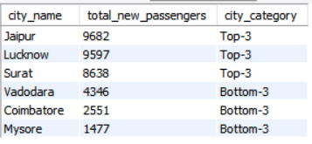
Good Cabs
Business Request-4: Identify Cities with Highest and Lowest Total New Passengers
Punam Godugula

Slide 12
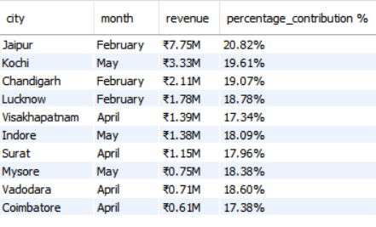
Good Cabs
Business Request-5: Identify Month with Highest Revenue for Each City
February and May stand out as high revenue performing months
Punam Godugula

Slide 13
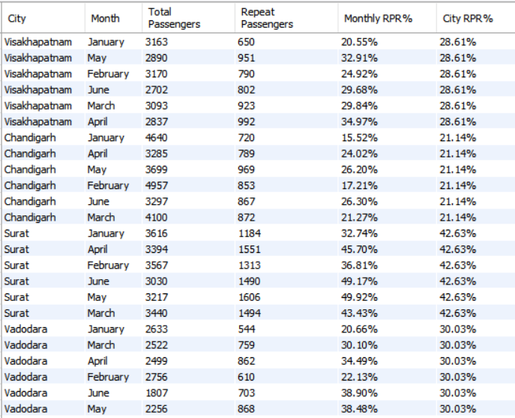
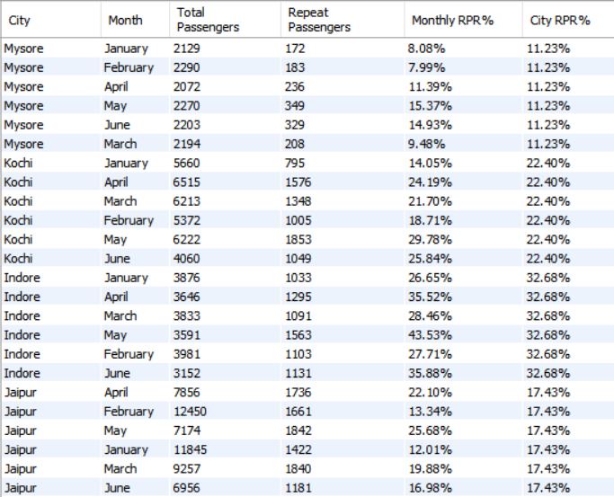
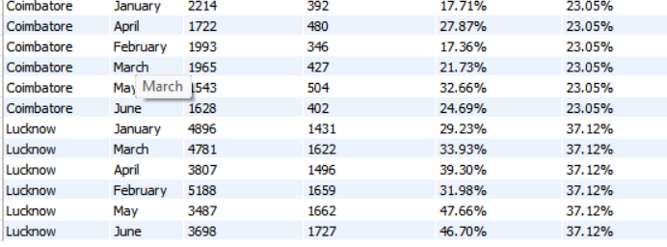
Good Cabs
Business Request-6: Repeat Passenger Rate Analysis
1.
Punam Godugula

Slide 14
Primary Analysis
Punam Godugula

Slide 15
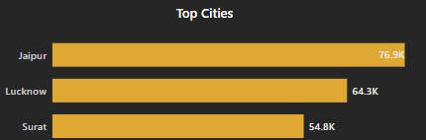
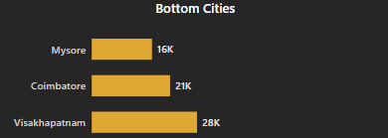
Top and Bottom Performing Cities
Identify the top 3 and bottom 3 cities by total trips over the entire analysis period
Top Performing Cities :
Jaipur, Lucknow and Surat
Indicates strong demand in this cities.
Bottom Performing Cities :
Mysore, Coimbatore and Visakhapatnam
Potential issues may be
Well developed public transport
Price sensitivity
Limited fleet availability
Poor App Experience
Punam Godugula

Slide 16
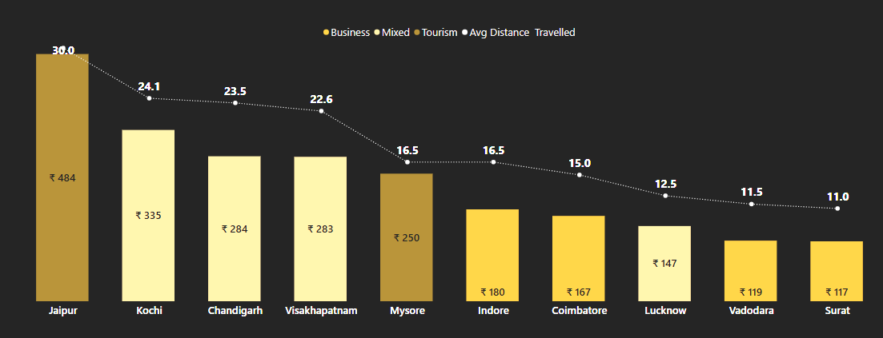
2. Average Fare per Trip per City
Calculate the average fare per trip for each city and compare it with city’s average trip distance. Identify the cities with the highest and lowest average fare per trip to access pricing efficiency across locations.
Jaipur tops in both trip revenue (₹484) and avg. distance (30 km) due to strong tourism demand.
Kochi, Chandigarh, Visakhapatnam show healthy revenue (₹283–₹335) with longer travel, driven by mixed demand (tourism + business).
Surat, Vadodara, Lucknow have lower trip counts and shorter distances (11–12.5 km), resulting in less revenue per trip (₹117–₹147).
Punam Godugula

Slide 17
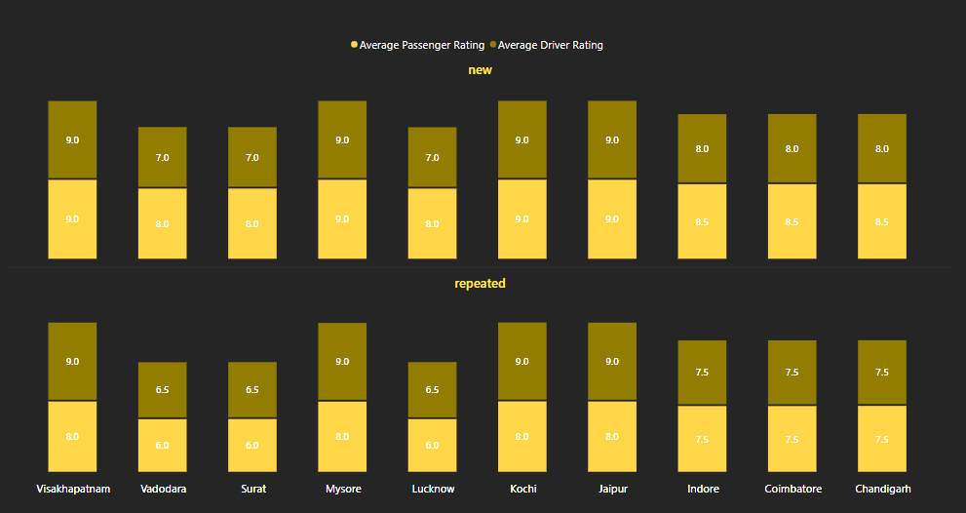
3. Average Rating by City and Passenger Type
Calculate the average passenger and driver ratings for each city segmented by passenger type (new vs repeated). Identify cities with the highest and lowest average ratings.
Tourist cities (Jaipur, Mysore) shows overall rating of 9⭐ passengers and driver rating, indicates high service quality.
Business Cities (Surat, Vadodara) shows 7.5/10 for new passengers but for repeated passengers the drivers rating is 6.5 indicates :
Inconsistency in service
Lack of Passengers Engagement
Punam Godugula

Slide 18
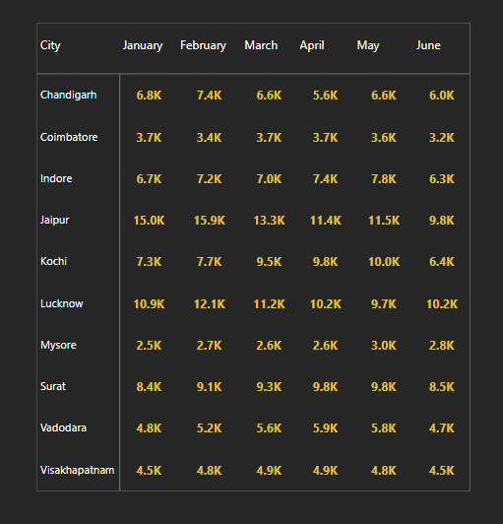
4. Peak and Low Demand Months by City
For each city Identify the month with the highest total trips (peak demand) and month with lowest trips (low demand). This analysis will help good cabs understand seasonal patterns and adjust resource accordingly.
Peak Demand Months :
February : Festival and Wedding season
April and May : Summer vacation starts
Low Demand Months :
January: Post-Holiday month
June : Monsoon Onset for travel disruptions
Punam Godugula

Slide 19
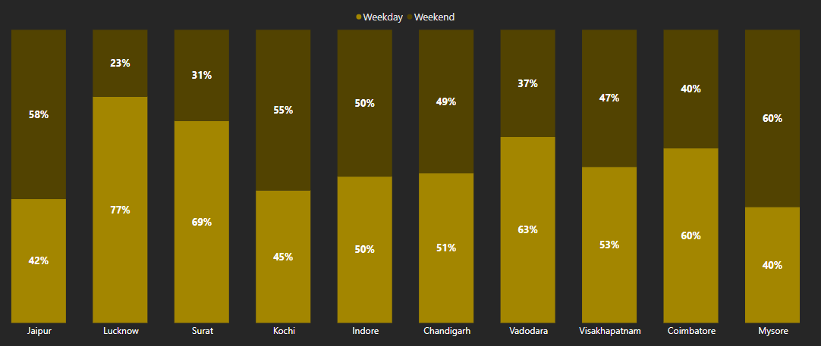
5. Weekend vs Weekday Trip Demand
Compare the total trips taken on weekdays vs weekends for each city over the period of six months. Identify cities with Strong preference for either weekend or weekday trips to understand demand variations
Tourist Cities like Jaipur(58%) and Mysore (60%) shows higher demand during Weekend.
Business centric cities like Lucknow(77%), Surat(69%) and Vadodara (63%)shows clear preference for weekday demands.
Mixed cities like Indore(50-50),
Chandigarh(51-49) and Kochi(45-55) have balanced demand between weekday and weekends.
Punam Godugula

Slide 20
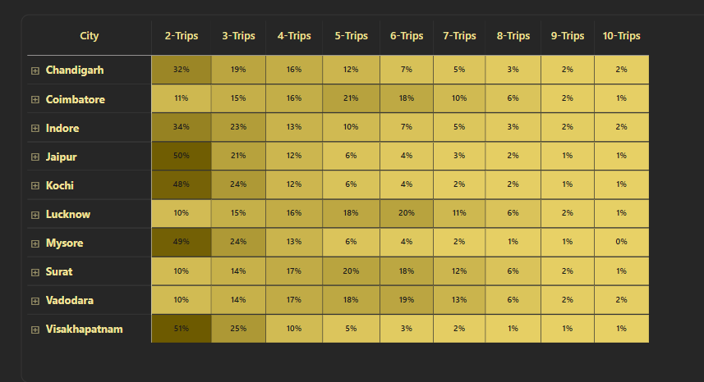
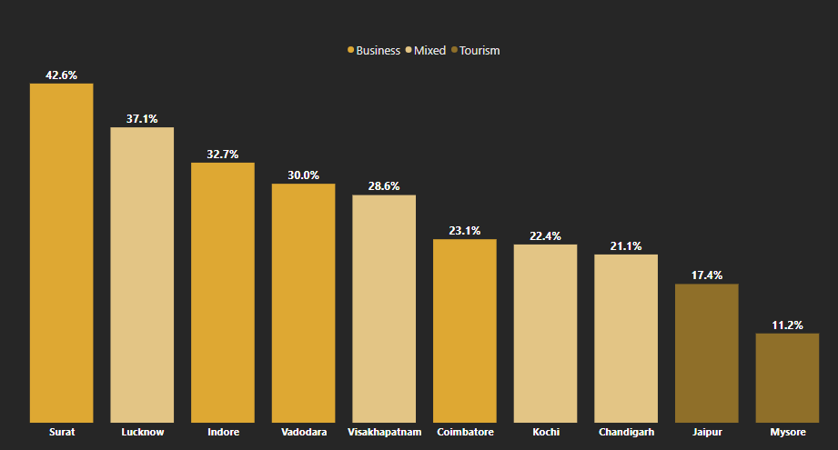
6. Repeat Passengers Frequency and City Contribution Analysis
Analyse the frequency of Trips taken by repeat passengers in each city.
Tourist Cities like Jaipur and Mysore have lower repeat passengers’ frequency (<20%)
Business centric cities shows higher RPR value due to the frequent travelling (43-23%)
Mixed cities shows are good distribution of RPR (37-21%).

Slide 21
Monthly Target Analysis for Key Metrics
Punam Godugula

Slide 22
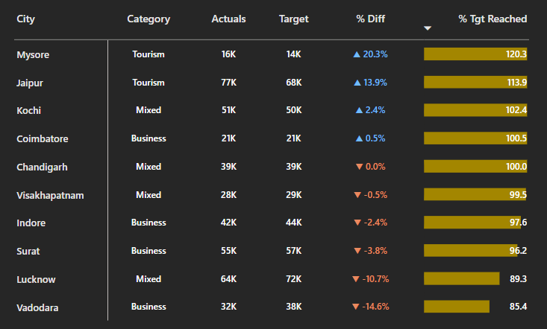
Total Trips
Punam Godugula

Slide 23
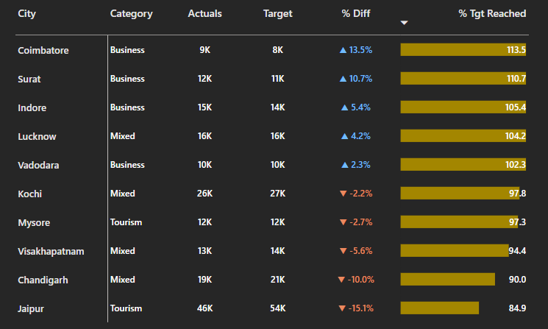
New Passengers
Punam Godugula

Slide 24
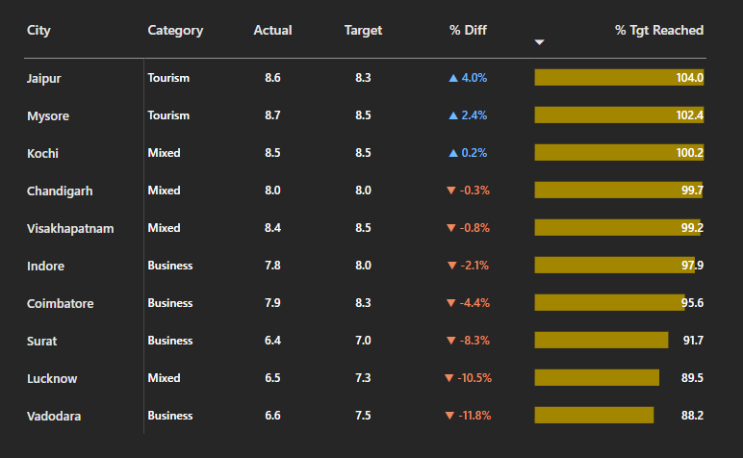
Average Passenger Rating
Punam Godugula

Slide 25
Further Analysis and Recommendations
Punam Godugula

Slide 26






Factors Influencing Repeat Passengers Rate(RPR)
What factors contribute for higher and lower RPR in different cities ? Are there any correlations with socioeconomic or lifestyle patterns in these cities
City Classification Impact
Tourist-Centric
Low RPR (Jaipur, Mysore)
Commuter-Heavy
High RPR (Surat, Vadodara)
Mixed Usage
Variable RPR (Kochi, Lucknow )
Factors Influencing RPR
Service Quality Factors
Technological Solutions
Socioeconomics Correlation
Seamless booking
Personalized user experience
Reliable ETA (est. time of arrival) predictions
Upper/Middle income areas
Entertainment zones
Age demographics: 20-45
Consistent arrival time
Vehicle maintenance
Driver professionalism
Impact on RPR : +15-20%
Impact on RPR : +25-30%
Impact on RPR : +10-35%
Punam Godugula

Slide 27


2. Tourism vs Business Demand Impact
How tourism and business or local events (festivals, conferences) impact GoodCabs demand pattern? Would tailoring marketing efforts to these events increase trip volume in tourism- oriented cities ?
Factor | Tourist Cities (e.g., Jaipur, Mysore) | Business Cities (e.g., Lucknow, Surat)
📅 Trip Timing | Peak on weekends, holidays, festive seasons | Higher on weekdays, office hours
📈 Trip Volume Variability | Seasonal spikes (holidays, festivals) | Consistent demand year-round
🧍‍♂️ Passenger Type | Families, solo tourists, leisure groups | Working professionals, daily commuters
🔁 Repeat Rate (RPR) | Lower → One-time or occasional users | Higher → Frequent office commutes
Impact of Targeted Marketing
Tourist City Strategies
Business City Strategies
Festival Focus
Conferences
Events
Corporate
Current
+ 60%
current
+ 70%
+ 45%
+ 35%
Align promotions with festival calendars
Offer event-based trip packages
Conference venue partnership
Promote cooperate tie-ups and loyalty programs
Punam Godugula

Slide 28

3. Emerging Mobility Trends and Goodcabs Adaption
What emerging trends (EV adoption, green energy use) are impacting the cab service market in tier-2 cities ? Should Goodcabs consider integrating EV or eco-friendly initiatives to stay competitive ?
Tier-2 Cities : EV Market Trends
Goodcabs EV Strategies
32 %
Annual Growth
Phased Approach
Full Transition
2.4x ROI
(vs 48% in metro areas)
57%
Tiered Implementation
Customers value sustainability
Lower charging infrastructure density (3.8x gap vs tier-1 cities)
Higher sensitivity to green premiums (-22% willingness to pay vs metro riders)
Higher Visibility routes first
“Green Rider” service (+18% revenue)
Business partnership for charging
Introducing EVs in tier-2 cities is a smart investment: costs are recovered in 3 years, profits can grow by 12% afterward, and the brand gains a competitive edge.

Slide 29
4. Partnership Opportunities with Local Business
What Are there opportunities for Goodcabs to partner with local business (such as malls, hotels and venue events) to boost demand and improve customer loyalty? Could these partnerships drive more traffic especially in tourism-heavy or high-footfall areas?
High-Value Partnership Targets
Hotels & Resorts
4.2x ROI
37% higher ride conversion vs. standard airport pickups.
Malls and Shopping Complexes
3.5x ROI
"Shop & Ride" programs increase evening ridership by 28% .
Event Venues & Tourist Attractions
4.8x ROI
Pre/post-event booking options capture 42% of transportation demand vs 17% walk-up.
Strategic Advantages for Goodcabs
Expands Customers Touchpoints
Enhanced Brand Visibility
Competitive edge
Market Penetration
Punam Godugula

Slide 30
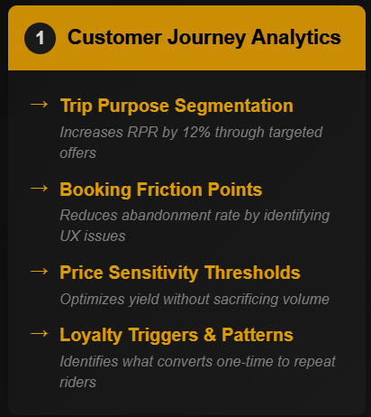
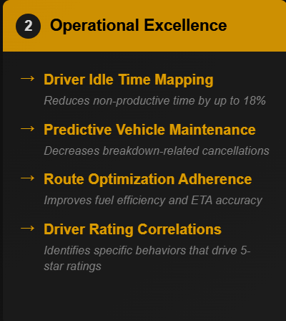
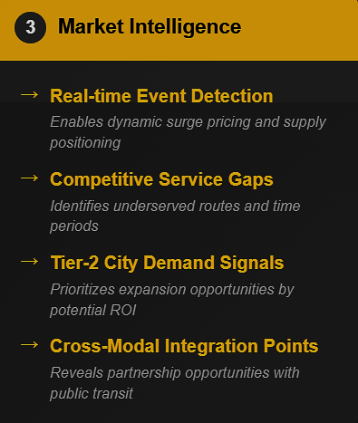
5. Data Collection for Enhanced Data Driven Decisions
What To make Goodcabs more data-driven and improve its performance across key metrics (such as RPR, customer satisfaction, new passengers and trip volume), what additional data should GoodCabs collect? Consider data that could provide deeper insights into customer behaviour, operational efficiency and market trends.
Punam Godugula

Slide 31
Thank You ☺
Punam Godugula

